Slide 1


SIMATS ENGINEERING
Saveetha Institute of Medical and Technical Sciences
Chennai-602105
CSA1543-Cloud Computing and Bigdata Analytics using SAN
Cloud-Based Online Expenses Tracker
Presentation By:
B Maheshwar (192411195)
T Deekshith (192472253)
Jaya simha(192425056)
Sameer Pasha(192425383)
Sai Teja(192424034)
Supervisor:
Dr. Chenni Kumaran J

Slide 2
Abstract
The project develops an online expense tracker using cloud storage and processing.
Users can input daily expenses, which are stored securely in the cloud.
The system generates summaries, charts, and reports for easy understanding of financial data.
Cloud integration ensures scalability, accessibility, and data security.

Slide 3

Introduction
Expense management is a common challenge faced by individuals and organizations.
Traditional methods (manual or offline tools) are inefficient and lack accessibility.
Cloud computing provides a scalable and reliable solution for storing and analyzing expenses.
Our project leverages cloud services to store expenses and generate reports for financial insights.

Slide 4
Objective
To develop a cloud-based application that enables users to record and manage their daily expenses efficiently while storing transaction data securely in the cloud.
To provide analytics and reports that help users understand their spending patterns through visual summaries and notifications, improving financial tracking and decision-making.

Slide 5
Problem statement
Many individuals find it difficult to track and manage their daily expenses effectively.
Traditional methods like manual records or basic apps do not provide secure cloud storage.
Lack of proper analysis tools makes it hard to understand spending patterns.
There is a need for a scalable cloud-based system that provides secure access, tracking, and financial insights.

Slide 6
Modules Used
Module 1: User Authentication & Cloud Identity Management
Module 2: Expense Entry & Transaction Management
Module 3: Cloud Database & Storage Management
Module 4: Analytics Dashboard & Report Generation
Module 5: Cloud Deployment, Notifications & Scalability Management

Slide 7
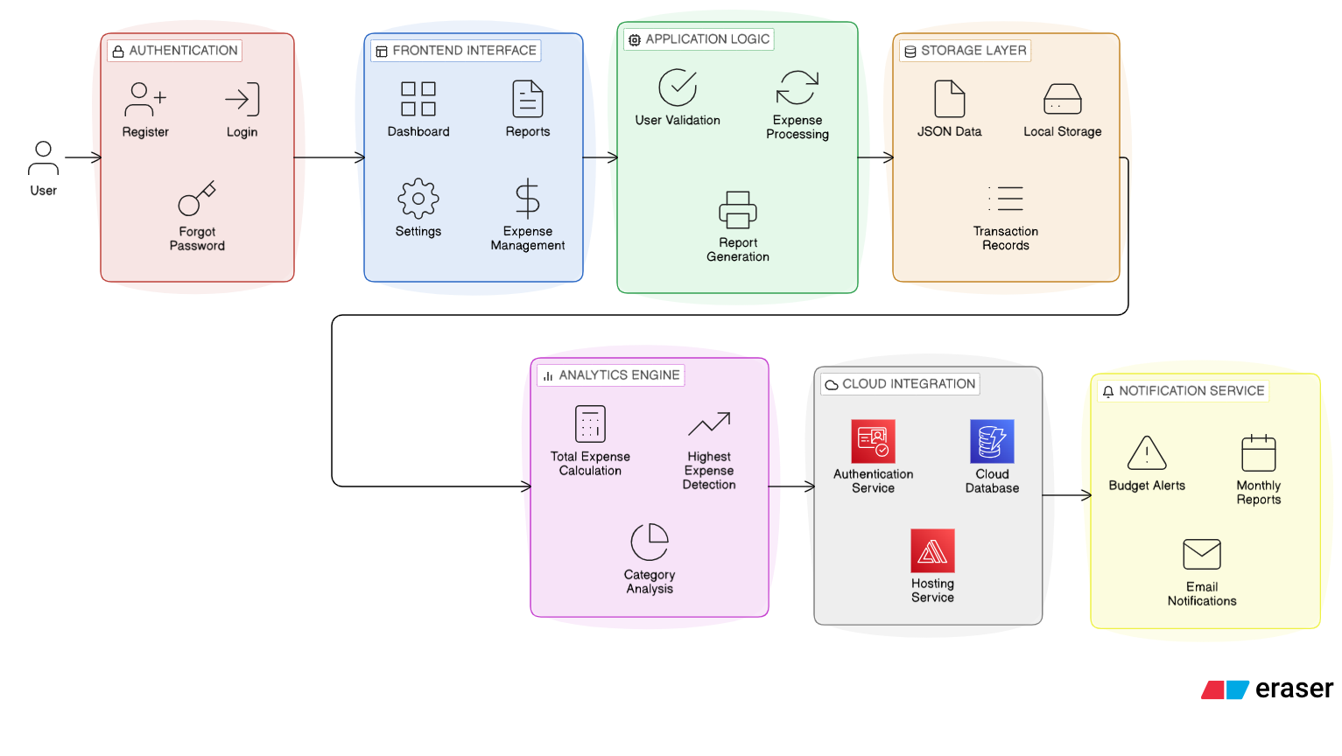
Architecture Diagram

Slide 8
Thank you

